Slide 1
EXAMINER TRANSITION TO DTA TRAINING
JULY 2018
Notes:
If I write text here will you read it

Slide 2
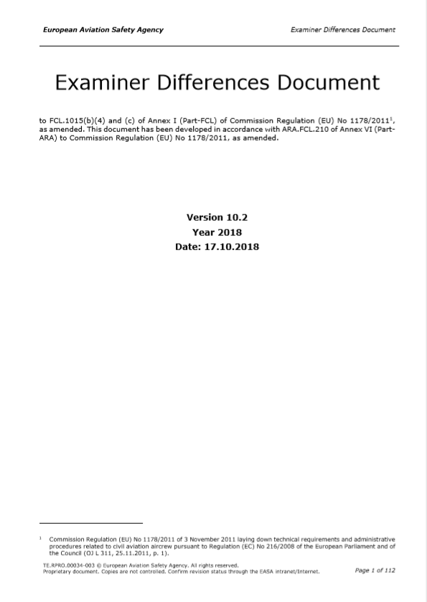
EXAMINER CERTIFICATES
WARNING
Examiners who have changed certificates will need to ensure all relevant authorities are aware of the changes and re-brief if necessary.
This task remains the examiners responsibility.
An agreement is nearly in place with the Swiss FOCA to simplify this transition for CAE.
If you have a certificate with 1000 (c) privileges DO NOT conduct EASA training in a member state as it will not be valid.
If in doubt please contact the BAT ATO Office.
Notes:
Review the differences document for the Danes! EDD image is hyperlinked to the EDD!

Slide 3
STATING THE OBVIOUS?
LICENCING CHECKS ARE CONDUCTED IN ACCORDANCE WITH THE GUIDANCE IN PART FCL APPENDIX 9
Where the confusion comes is which administrative procedures to apply for a specific check:
The guidance from the licencing authority of the applicant under check takes precedence. (Examiner’s Differences Document)
Where guidance does not exist the examiner should default to the guidance from the authority which holds their examiner certificate.

Slide 4
APPLICABILITY
THIS PRESENTATION IS AIMED TO PROVIDE STANDARDISING GUIDANCE TO EXAMINERS WHO HAVE TRANSFERRED TO DANISH EXAMINER CERTIFICATES
&
PROVIDE ALL EASA EXAMINERS GENERALLY INFORMATION ON THE DANISH TRANSPORT AGENCY INTERPRETATION OF APPENDIX 9 AS THE ADMINSTRATOR OF CAE’S APPROVED TRAINING ORGANISATION.

Slide 5
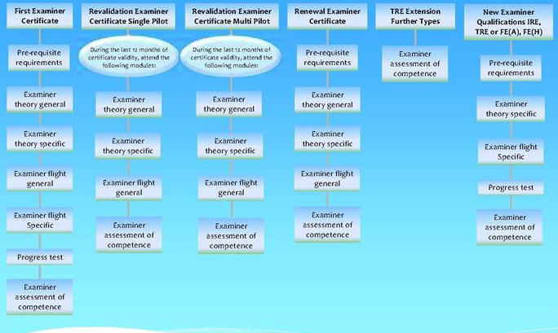
EXAMINER PRIVELIGES
Notes:
The image hyperlinks link to the DTA guidance, there is a link to the full guidance on this page but the overview should suffice.
As this is aimed at current examiners note that to add a type now requires an EAoC to be requested. Not clear as yet whether this will be a DTA inspector or CAE SE, but always DTA for initial EAoC

Slide 6
CHECKING GUIDELINES

Slide 7
GUIDELINES FROM DANISH CAA
4 possible outcome of each item on the test forms when conducting an LPC / LST / ATPL check:
Pass
Fail, but Examiner gives the applicant another attempt
Fail, and the Examiner does not give the applicant another attempt. This ITEM is failed.
Fail, and the Examiner does not give the applicant another attempt. The ENTIRE TEST is failed.

Slide 8
GUIDELINES FROM DANISH CAA
An example:
An applicant is flying an ILS and becomes unstable, he choses to perform a go-around.
What grade would you give him?
(b) Fail, but Examiner gives the applicant another attempt
Notes:
Examiner should only exercise option to repeat when the applicant has made a minor error, and it is clear that the applicant is aware of the issue, and how to resolve it without requiring training input.
UK CAA Equivalent of Repeat but without any briefing.

Slide 9
GUIDELINES FROM DANISH CAA
When should a pilot have a 2nd attempt at an item?
Whenever possible unless
The test standard is so poor that the Examiner require a complete retest
The Examiner determines that the standard of the item performed was so poor, that another attempt will not be at an acceptable standard
It does not make sense to give another attempt.

Slide 10
GUIDELINES FROM DANISH CAA
Another example:
An applicant is flying an ILS and becomes unestablished. He choses to perform a go-around.
He is then asked to fly another ILS and once again he becomes unestablished and he performs another go-around.
What grade would you give him?
(c) Fail, and the Examiner does not give the applicant another attempt. This ITEM is failed.
Notes:
There is a failure in the item, the Safety of Flight is not an issue, leading to Partial Pass and second attempt.
This takes place as a separate event.

Slide 11
GUIDELINES FROM DANISH CAA
An example:
An applicant is flying an ILS and becomes unestablished below the MSA. He choses to continue the approach and lands the aircraft.
What grade would you give him?
(d) Fail, and the Examiner does not give the applicant another attempt. Any item where the aircraft is not operated in a safe and responsible way, circumstances taken into account = FULL FAIL (The entire test is failed).

Slide 12
GUIDELINES FROM DANISH CAA
Fail, and the Examiner does not give the applicant another attempt. The entire test is failed. This grade will be given if the applicant performs in a way that negativly effects
SAFETY OF FLIGHT
Examples:
Incorrect go/no-go decision
Approach below minima
Non-compliance with clearence
Take off or landing on wrong runway

Slide 13
IN SUMMARY
1. PASS | 2. FAIL Examiner Gives applicant another attempt
 | Examiner should only exercise option to repeat when the applicant has made a minor error, & it is clear that the applicant is aware of the issue, &how to resolve it without requiring training input.
3.FAIL The ITEM is Failed | 4. FAIL The Test is Failed FULL FAIL
There is a failure in the item, the Safety of Flight is not an issue, leading to Partial Pass and second attempt. This takes place as a separate event. | The Safety of Flight is impacted Or more than five items failed
SECOND ATTEMPT HAVE ALL TEST/CHECK ITEMS BEEN EXAMINED?
YES – COUNT UP FAILED ITEMS
FAILED ITEMS ≤ 5 = PARTIAL PASS
(Examiner’s discretion)
FAILED ITEMS > 5 = FULL FAIL
(No examiner’s discretion)
TRAINING MAY TAKE PLACE ON THE FAILED ITEMS
Retraining cannot take place during a check.
TRAINING MUST TAKE PLACE
Examiner’s Recommendation of extent of training
SECOND ATTEMPT (RETEST FAILED ITEMS)
Second Attempt rules
One repeat is accepted in the partial passed retest
Any single item fail = Check Failed
NOT TO
STANDARD
= FAIL
RETAKE NEW &
DIFFERENT CHECK/TEST
STANDARD ACHIEVED
PASS AT SECOND ATTEMPT
Notes:
A pilot for a type rating skilltest does all items up to standard in the 1st attempt except 2D approach, TCAS and SE go around.
Examiner decides it is acceptable to retry these 3 items. (2nd attempt)
After 2nd attempt on all 3 items the SE go around is still sub standard and the final result is a partial pass.
A couple of days later the pilot is up for the partial pass (SE go around only) and on the first attempt the maneuver is not up to standard and again the Examiner decides to giver another try (2nd attempt).
If this 2nd attempt of the check for these items are up to standard, the final result is pass and if not, the final result is fail.

Slide 14
CONDUCT OF THE CHECK

Slide 15
CONDUCT OF THE CHECK
00:15 Pre-examination
The objective of the flight;
Licensing and identification checks, as necessary;
Freedom for the ‘candidate’ to ask questions;
Operating procedures to be followed (for example operators manual);
Weather assessment;
Respective roles/ operating capacity of ‘candidate’ and examiner
Aims to be identified by ‘candidate’;
Simulated weather assumptions (for example icing and cloud base);
Contents of exercise to be performed;
Agreed speed and handling parameters (for example V-speeds, bank angle, approach minima);
Use of R/T (for example during emergency);
Criteria for success & possible outcome of test;

Slide 16
CONDUCT OF THE CHECK
00:15 Pre-examination
00:45 Theoretical check
Performance
AC systems and operations
Planning
Wx requirements
General knowledge PANS OPS etc
FCL privileges and conditions
Regulations.

Slide 17
CONDUCT OF THE CHECK
00:15 Pre-examination
00:45 Theoretical check
00:15 Pack up and go to simulator
02:00 / 04:00 Simulator

Slide 18
CONDUCT OF THE CHECK
00:15 Pre-examination
00:45 Theoretical check
00:15 Pack up and go to simulator
02:00 / 04:00 Simulator
00:30 De-briefing
Facts based & Objective
Facilitative & Non Chronological
All feedback to the student must be given here
If possible use documentation, print outs etc

Slide 19
CONDUCT OF THE CHECK
00:15 Pre-examination
00:45 Theoretical check
00:15 Pack up and go to simulator
02:00 / 04:00 Simulator
00:30 De-briefing
00:15 Administration
04:00 / 06:00 Total

Slide 20
PROFICIENCY CHECK
The pilot is being tested
SOP
AC systems
Procedures
AC handling
General Aviation Knowledge
Feedback drives pilot competencies improvement

Slide 21
TYPE RATING SKILL TEST
The ATO is being tested
Aircraft systems
Aircraft procedures
Aircraft performance
Aircraft handling
Feedback drives ATO Instructor competencies and ATRC improvements
Notes:
LICENCE SKILL TEST

Slide 22
ATPL SKILLS TEST
The pilot is being tested
Communication
Leadership
Captaincy
Prioritizing
Decision making
Feedback drives pilot competencies improvement

Slide 23
PAPERWORK

Slide 24
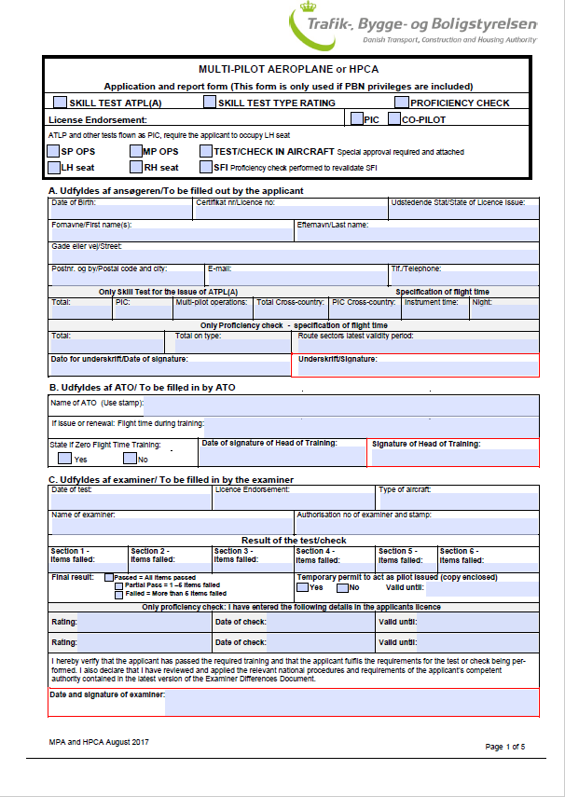
DANISH CHECKING PAPERWORK
DTA REGULATORY PAPERWORK
Part A is to be completed by applicant
Part B is to be completed by ATO for initial type ratings & renewals ONLY
Part C is to be completed by the examiner

Slide 25
TEMPORARY CERTIFICATES
THE DANISH TRANSPORT AGENCY DO NOT ISSUE TEMPORARY CERTIFICATES
Where certification is required by the DTA as a matter of urgency, send the paperwork by e-mail to info@TBST.dk ~ Subject Initial Issue.

Slide 26
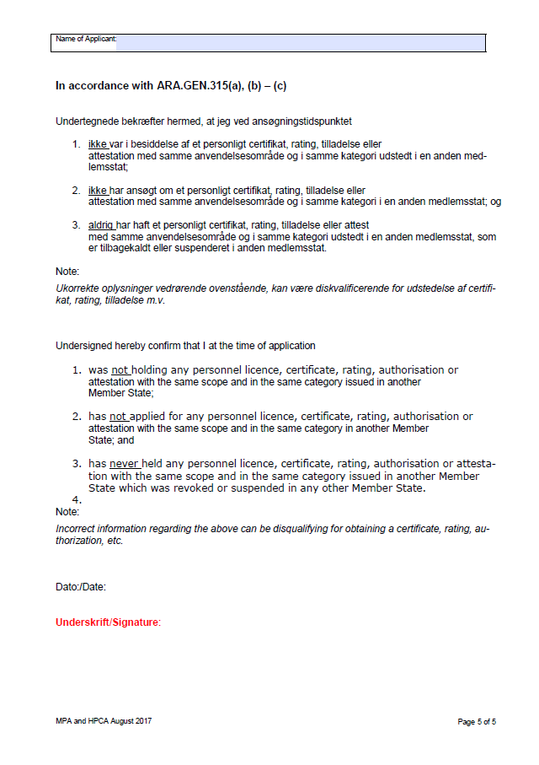
DANISH CHECKING PAPERWORK
CAUTION
PRIOR TO COMMENCEMENT OF ANY LICENCE SKILLS TEST, ATPL SKILLS TEST, LICENCE PROFICIENCY CHECK
THE ARA.GEN.315 DECLARATION MUST BE SIGNED BY THE APPLICANT
Notes:
The declaration is at the back of the check form,

Slide 27
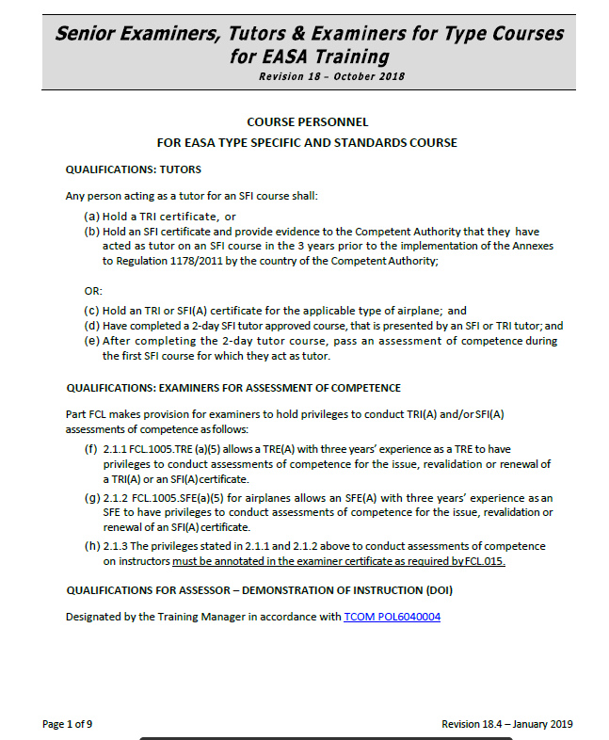
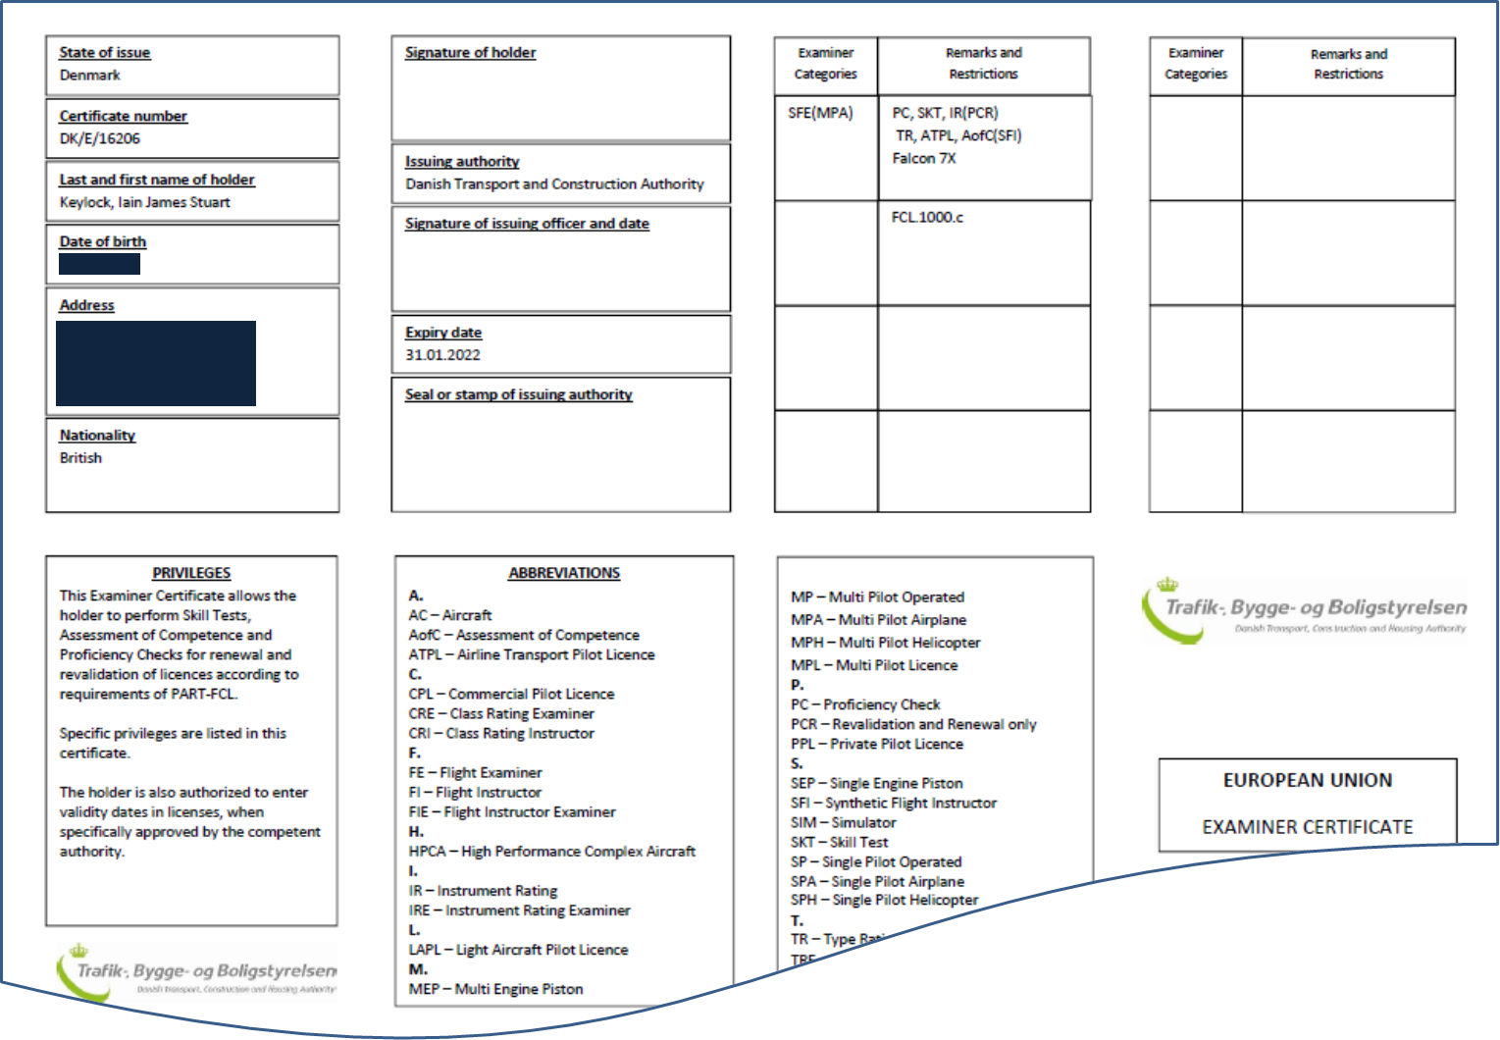
INSTRUCTOR ASSESSMENT OF COMPETENCES
NOTE
TO CONDUCT AN ASSESSMENT OF COMPETENCE AN EXAMINER MUST HAVE AofC(SFI) ON THEIR CERTIFICATE
&
ON THE CAE APPROVAL LIST ON THE TCOM
EASA ATO SHAREPOINT
ATO DESIGNATION OF KEY PERSONNEL
TUTORS-EXAMINERS FOR TYPE COURSES

Slide 28
EASA INITIAL SFI TRAINING PROCESS
PRE NOTIFICATION
OF COURSE
TO ATO
NOTIFICATION OF AoC TO DTA
(1ST DAY OF COURSE)
SFI COURSE COMPLETED
DTA PAPERWORK & TRAINING RECORDS
TO ATO
TRAINING RECORDS VALIDATED
&
DTA PAPWORK
TO DTA
DTA RELEASE COPIES TO ATO
&
ORIGINAL CERTIFICATE SENT TO CANDIADTE
ATO OFFICE RECONCILES COURSE NOTIFICATIONS WITH DTA CERTIFICATES
All paperwork to EASA-applications@cae.com & CC applications on DTA notifications
BAT TRAINING
CENTRE
 | Required Documents
1 | Instructor Assessment of Competence TRI and SFI
2 | Certificate of Course Completion
3 | Current LPC/LST – Copy of Paperwork
 | Additional Requirements for Non EASA Licence Holders
4 | Copy of non-EASA licence
5 | Copy of Passport
6 | Copy of Driving Licence (Proof of address)
EASA ATO
OFFICE
DANISH TRANSPORT AGENCY

Slide 29
EASA SFI REVALIDATION or RENEWAL PROCESS
Revalidation. For revalidation of an SFI certificate the applicant shall, within the validity period of the SFI certificate, fulfil 2 of the following 3 requirements:
complete 50 hours as an instructor or an examiner in FSTDs, of which at least 15 hours shall be within the 12 months preceding the expiry date of the SFI certificate;
(2) receive instructor refresher training as an SFI at an ATO
(3) pass an assessment of competence
Renewal. The applicant shall, within the 12 months preceding the application complete the simulator content of the SFI training course, plus (2) & (3) above.
SFI REVALIDATION OR RENEWAL COMPLETED
DTA APPLICATION
SUBMITTED
TO ATO
DTA APPLICATION
VALIDATED & SUBMITTED
TO DTA
DTA RELEASE COPIES TO ATO
&
ORIGINAL CERTIFICATE SENT TO CANDIADTE
ATO OFFICE RECONCILES APPLICATIONS
WITH DTA CERTIFICATES
All paperwork to EASA-applications@cae.com & CC applications on DTA notifications
BAT TRAINING
CENTRE
 | Required Documents
1 | Instructor Assessment of Competence TRI and SFI
2 | Revalidation and renewal instructor privileges
3 | Current LPC/LST
4 | SFI Refresher if revalidating by experience
EASA ATO
OFFICE
DANISH TRANSPORT AGENCY

Slide 30
DANISH ASSESSMENT OF COMPETENCE PAPERWORK
CAUTION
PRIOR TO COMMENCEMENT OF AN INSTRUCTOR AoC
THE ARA.GEN.315 DECLARATION MUST BE SIGNED BY THE APPLICANT
5 DAYS ADVANCE NOTIFICATION MUST BE GIVEN TO THE DANISH TRANSPORT AGENCY
Notes:
Note the additional comment at the bottom with regard notification, this applies whether a Danish Examiner or not. IE ALWAYS NOTIFY
The declaration is at the back of the check form.

Slide 31
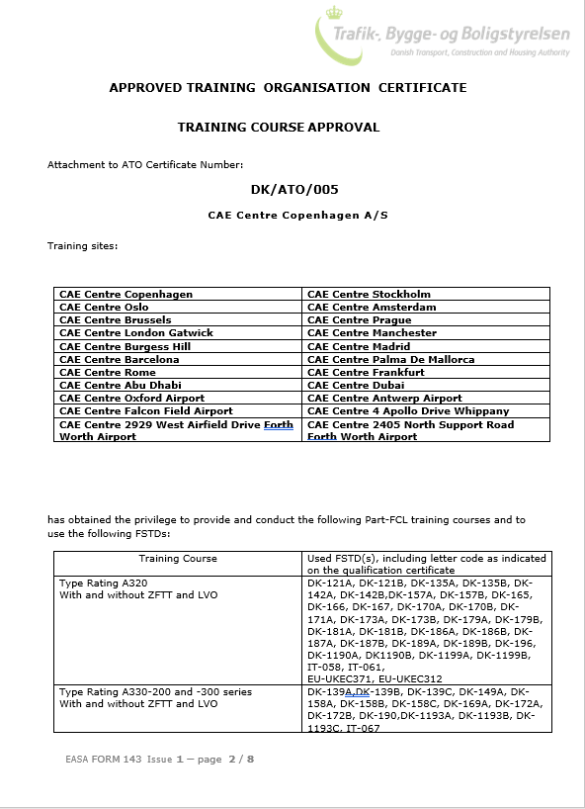
ATO CERTIFICATE
Ensure new ATO certificate incorporated into “Examiner’s reports” in the client’s course records
Ensure the required approvals courses are covered in the BAT Branch Manual as the ATO Certificate covers the global ATO and some courses may not be applicable for BAT use.
Available for review at client services & on TCOM

Slide 32
STAYING STANDARDISED
Danish Transport Agency
Examiner Website
DK Examiners have no English Language Proficiency privileges at this time
Notes:
Demonstrate the various support and standardising support available on the DTA examiners website.
We are working on a solution to the ELP issue, but not in place at this time.

Slide 33
Questions?
33

